Slide 2
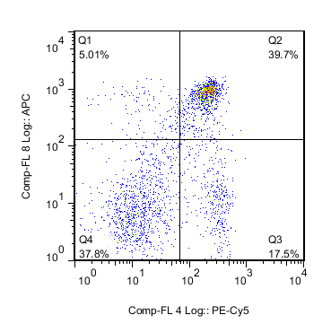
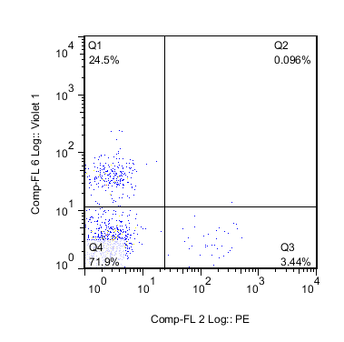
CD8
CD19
CD4
CD11c

Slide 3
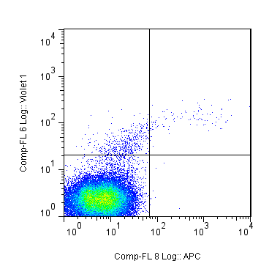
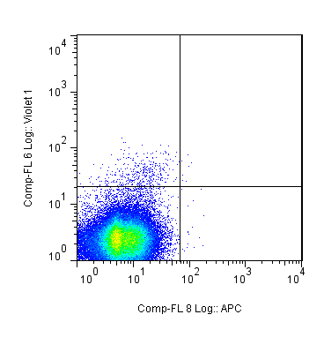
CD19+ Recipient Spleen
7 days
11 days
CD19+IgM+
0.205%
CD19+IgM+
0.008%
CD19
CD19
IgM
IgM
Notes:
CD19+
11.6.15,

Slide 4
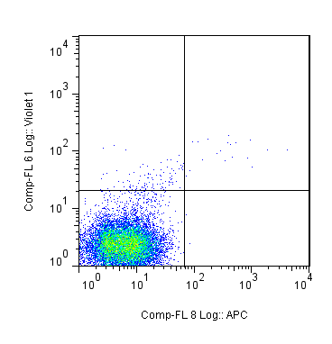
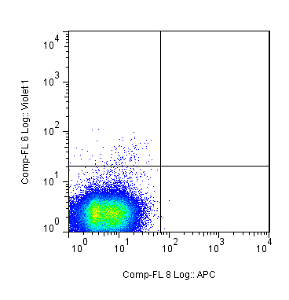
CD19- Recipient Spleen
7 days
11 days
CD19+IgM+
0.141%
CD19+IgM+
0%
CD19
CD19
IgM
IgM
Notes:
CD19-
11.6.15,

